Slide 1
prototype
Our prototype aims a person to record his/her exercises during workout. We featured a mobile web interface assuming that each person uses one’s mobile phone to keep their workout lists.

Slide 2
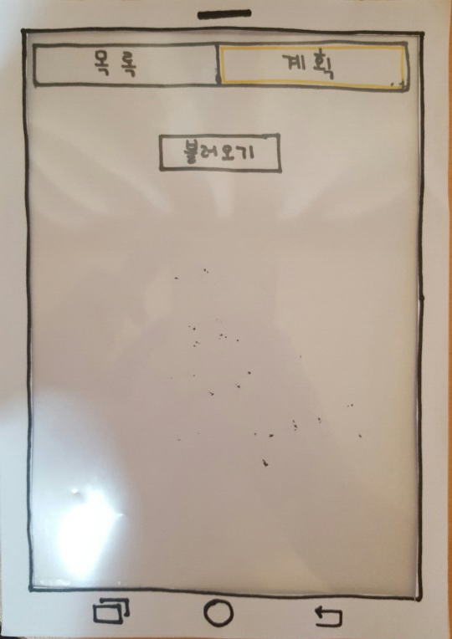
In the beginning, our UI simply shows two tab like selectors and one button each of which indicates list for all kinds of exercises, personal plan for one’s exercise and reloading option for previously saved workout patterns.

Slide 3
Task 1

Slide 4
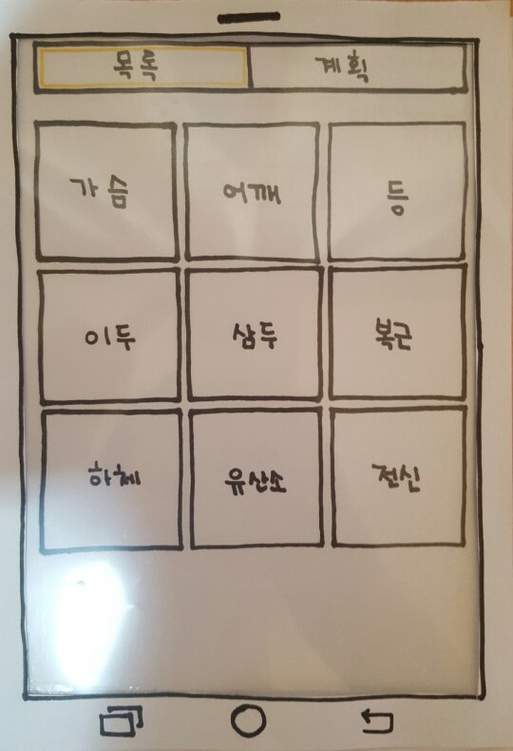
For the first task, user starts with pressing ‘목록’ in the very first view. Each grids indicate which part to choose for. Let’s say we pressed ‘가슴’

Slide 5
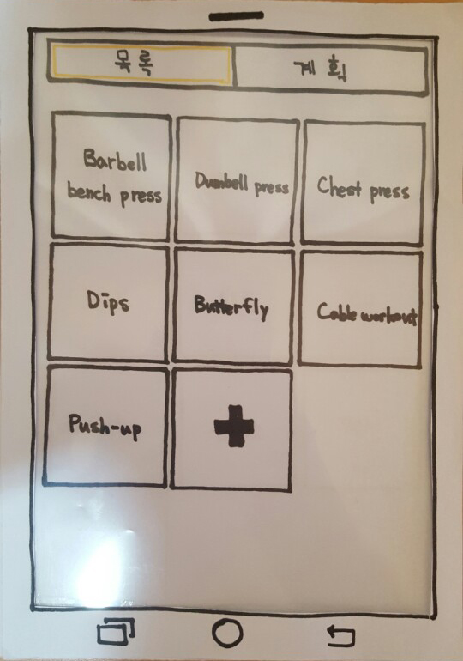
After choosing which part of the body to be stimulated, we can choose an item from grids indicating exercises that are classified under that part of the body. Let’s say we chose ‘Barbell bench press’.

Slide 6
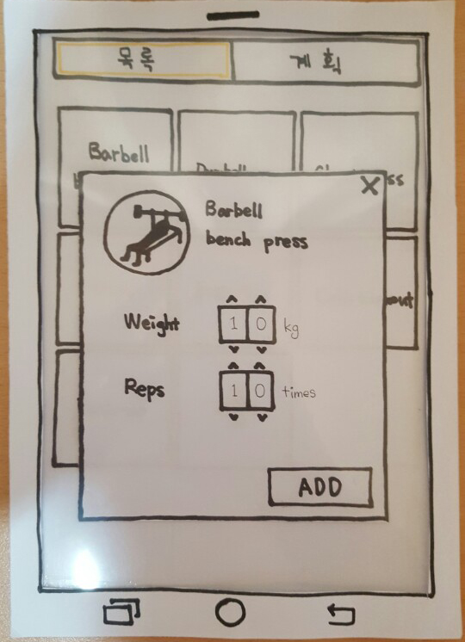
A pop-up for adding the exercise to personal plan shows up and user can select weight as well as reps on that popped up page. Note that we separated tenth digit and ones place that user can select weight and reps within little clicks or touches. Note that Reps stands for repetitions.

Slide 7
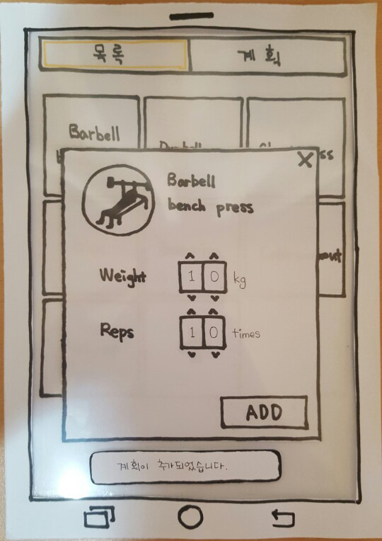
When ADD button is pressed, a set is added to one’s workout plan. Note that the number of button clicks indicate the number of sets the workout has been planned. This ‘each-click-for-setting-sets’ feature was designed because it is common that each workout set can be consists of different combinations of weight and reptitions.

Slide 8
Task 2

Slide 9
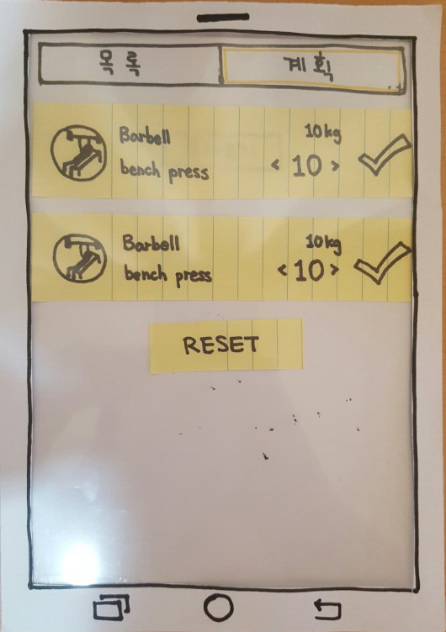
After additions, those attempts are reflected in plan section. The user now can check or modify the number of repetitions. If the number of repetitions has been diminished and then checked, the bar would be colored differently, indicating that user could not finish the workout plan.

Slide 10
Task 3

Slide 11
If the room for plan is empty, we provide a special feature, namely ‘불러오기’ so that user can retrieve past record settings(or patterns). Let’s say the button is being pressed.

Slide 12
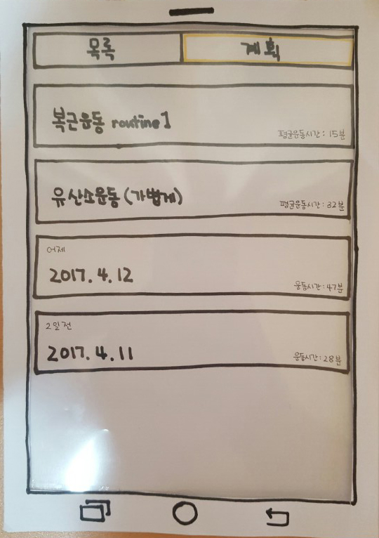
List shows up which holds the records the user had been recorded before with date or the workout pattern which is manually subscribed. Let’s say the first element is being pressed.

Slide 13
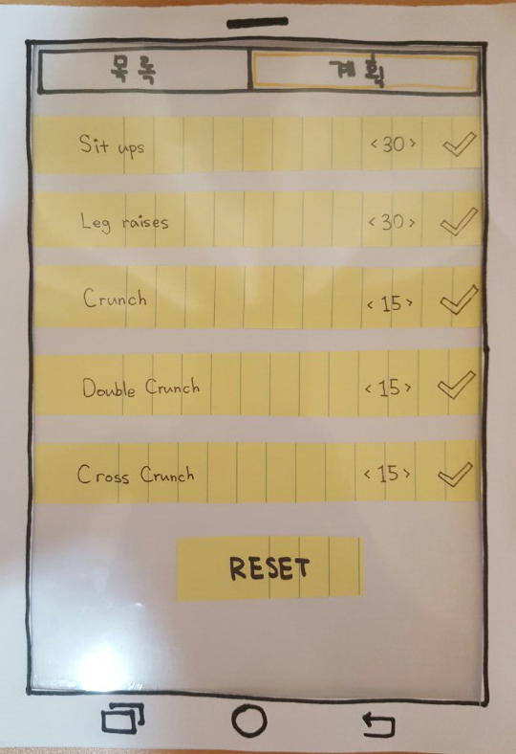
After that, those pre defined exercise lists are now inserted in plan page so that user can again check or modify the number of repetitions.

